Slide 1
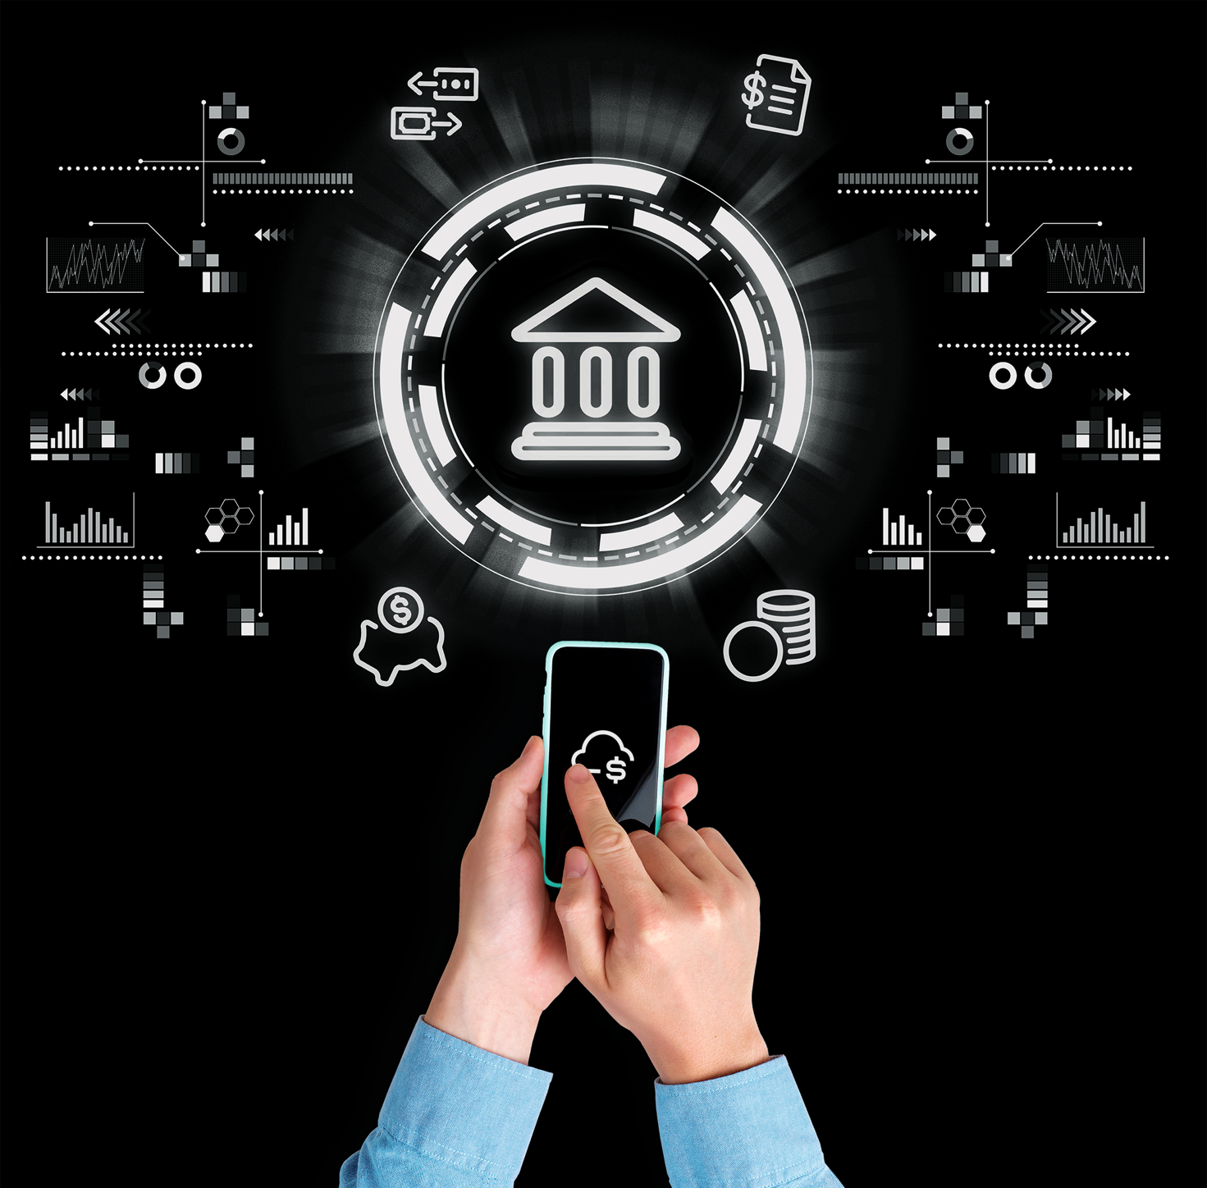

Azure Virtual Desktop (AVD)
Architecture - Design
FEBRURARY 13, 2025

Slide 2
Azure Virtual Desktop High-Level Setup with 3 Subscriptions
Architecture Overview:
Azure Virtual Desktop Environment:
AVD session hosts in Shared-Hub Subscription.
VNet peering between Shared-Hub and both Dev/Prod subscriptions for resource access.
Conditional Access via Entra ID for secure user authentication.
Users access Dev and Prod servers after connecting to AVD.
Scalability:
Scale AVD session hosts based on demand.
Use autoscaling for Dev and Prod servers to optimize cost and performance.

Slide 3
Shared-Hub Subscription:
Purpose: Centralized location for managing AVD infrastructure.
AVD Session Hosts: These are the virtual machines (VMs) that users will connect to for their desktop sessions.
AVD-Subnet: The subnet where all AVD session host machines will be deployed.
Networking: Peered with Dev and Prod subscriptions to enable seamless communication

Slide 4
Dev Subscription:
Purpose: Dedicated environment for development and testing.
Subnets:
App Subnet: Hosts application-tier VMs.
Web Subnet: Hosts web servers.
DB Subnet: Hosts database-tier VMs.
Prod Subscription:
Purpose: Production environment for live systems.
Subnets:
App Subnet: Hosts application-tier VMs.
Web Subnet: Hosts web servers.
DB Subnet: Hosts database-tier VMs.

Slide 5
VNet Peering:
Peering between Shared-Hub and Dev Subscription:
Establishes secure communication between the AVD session hosts and development environment VMs.
Peering between Shared-Hub and Prod Subscription:
Allows AVD users to access the production environment servers through secure communication.

Slide 6
User Access through AVD:
End-User Access:
Users will access AVD session hosts in the Shared-Hub Subscription.
Conditional Access with Entra ID: Enforces security policies (e.g., MFA, device compliance) to authenticate users before they can connect to AVD.
Once connected to the AVD session host, users can seamlessly access resources in both Dev and Prod subscriptions, based on their role and access permissions.

Slide 7
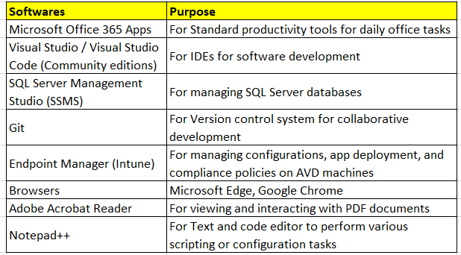
Software Installed on Azure Virtual Desktop (AVD)
Operating System:
Windows 11 Multi-Session:
The primary operating system used for AVD session hosts.
Ensures users have a personalized desktop experience in a multi-session environment.

Slide 9


